Slide 29
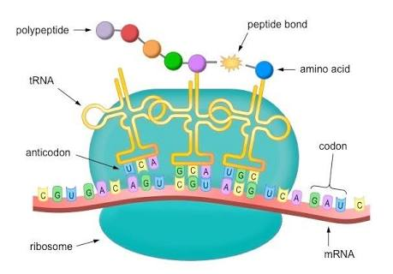

Slide 30
Thank you

